Slide 1


Slide 2
SECP3843 Special Topics Entry Survey
https://forms.gle/5hLVJJXG81oRM4vp8
SECP3843 Special Topics Course Survey
https://www.menti.com/alecf6xyue7d

Slide 3
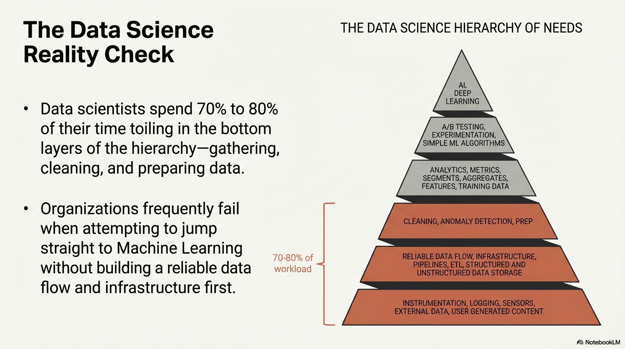

Slide 4
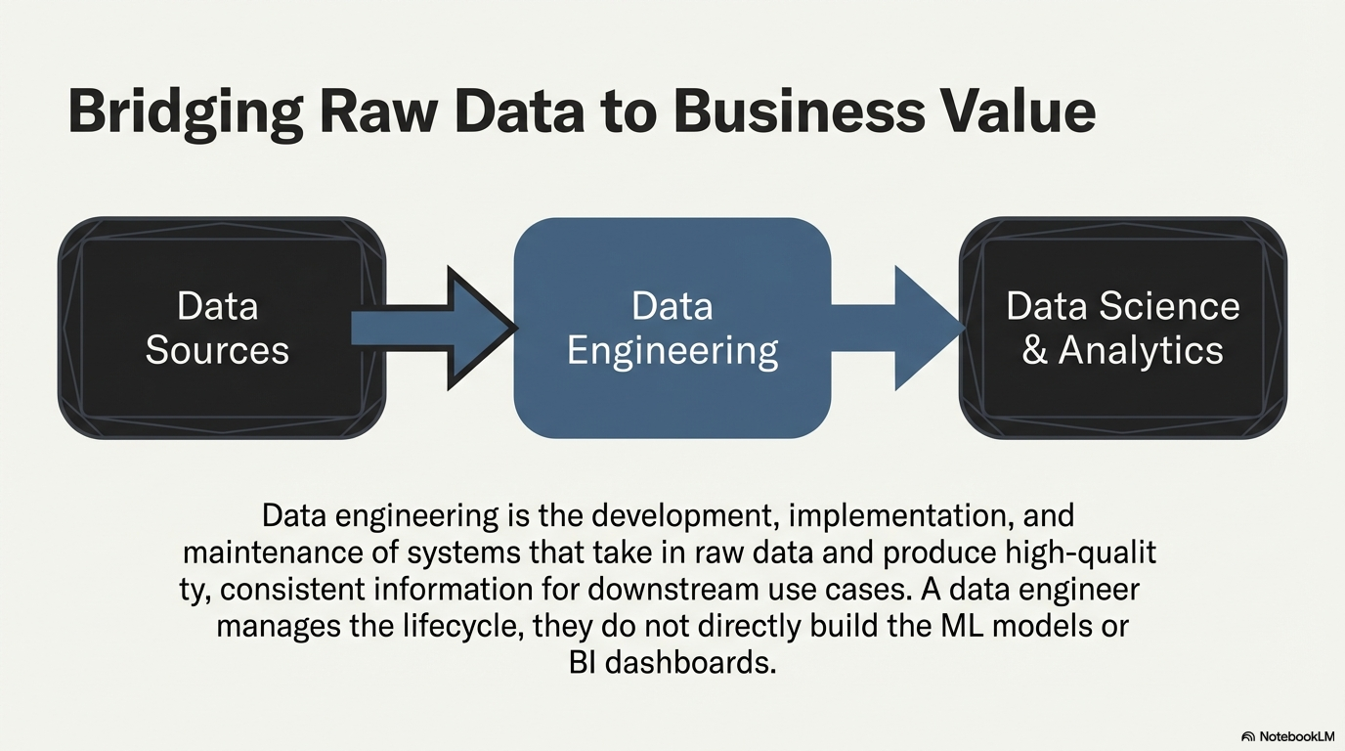

Slide 5
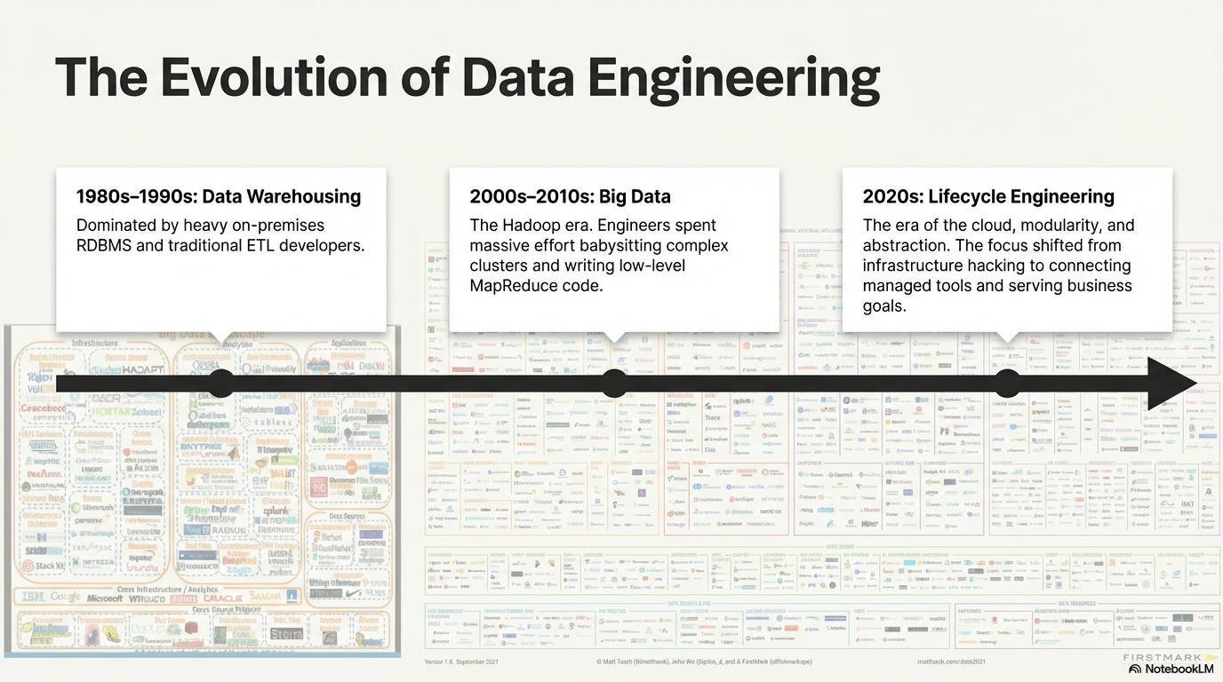

Slide 6
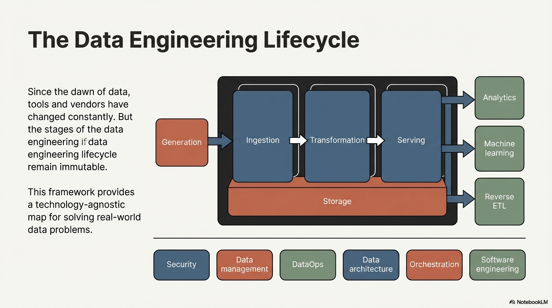

Slide 7
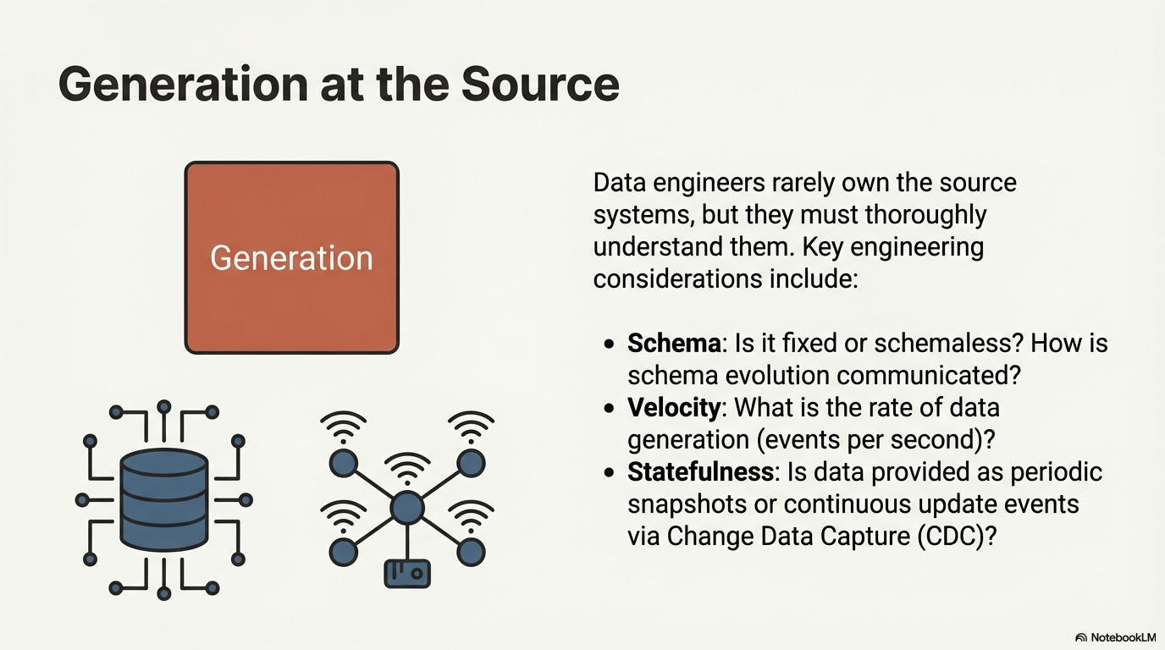

Slide 8
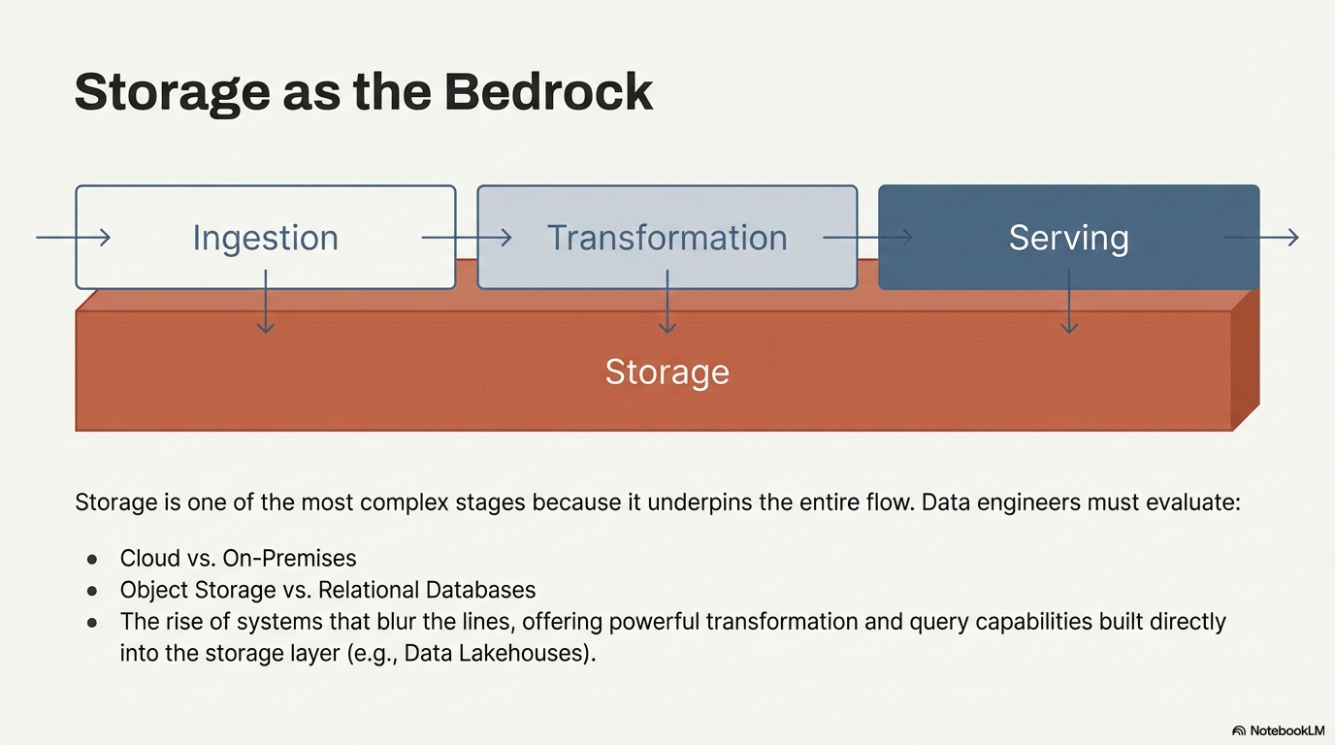

Slide 9
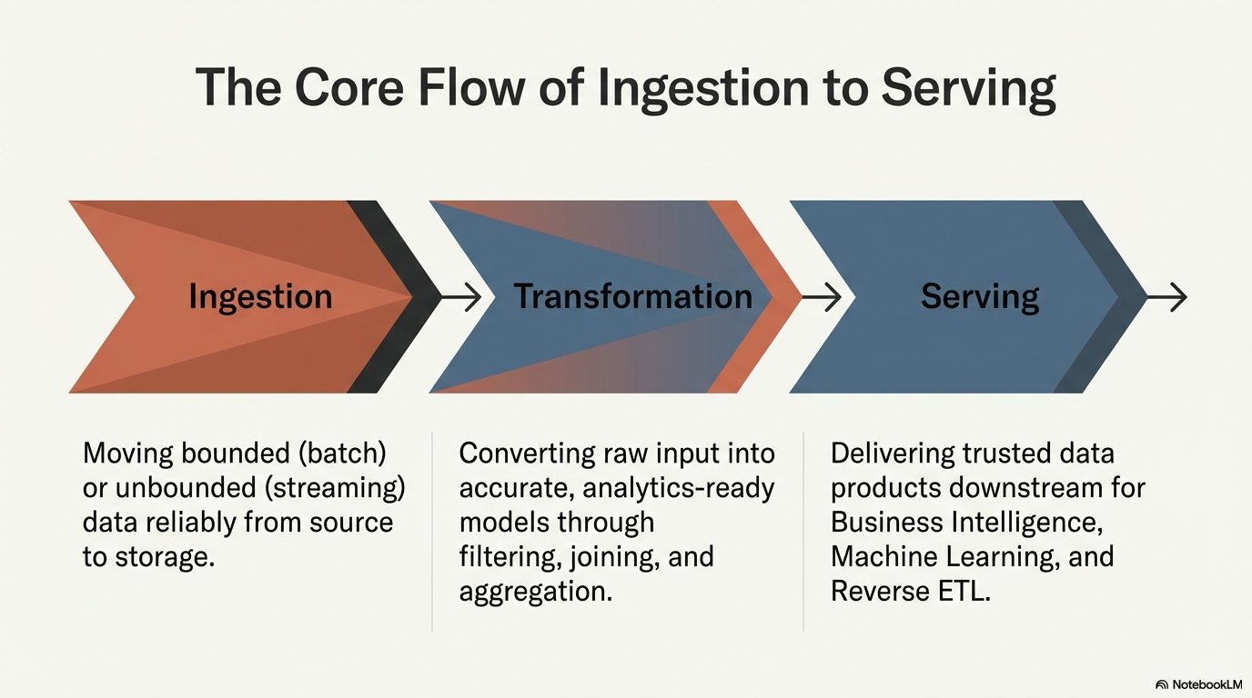

Slide 10
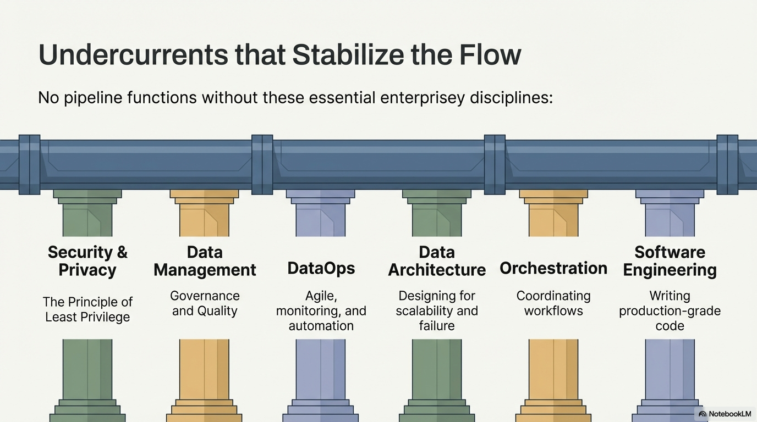

Slide 11
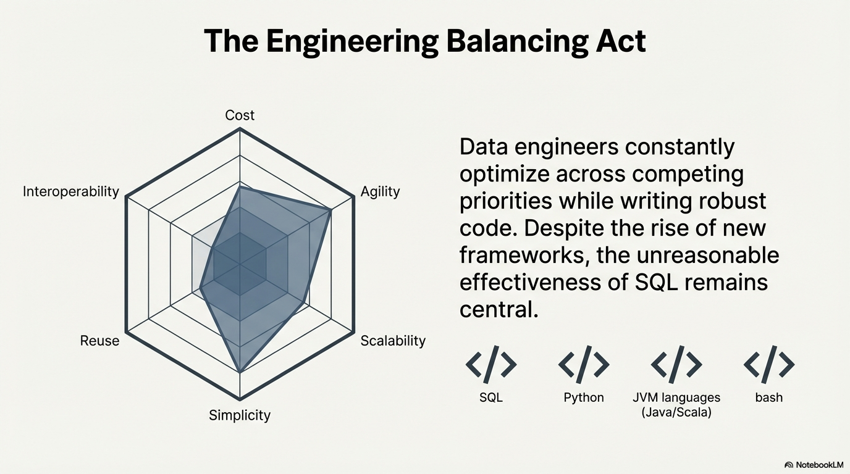

Slide 12
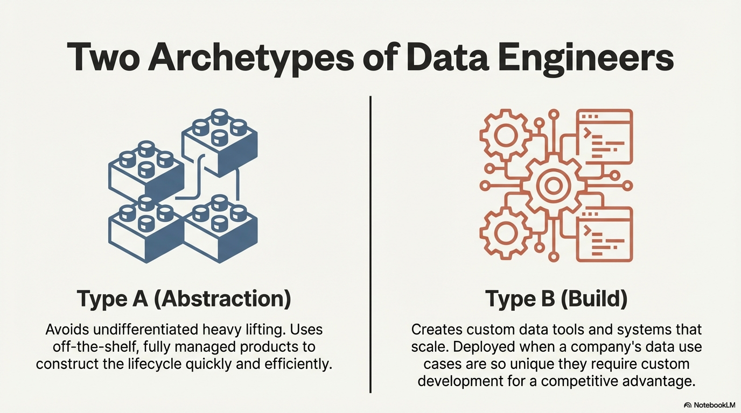

Slide 13
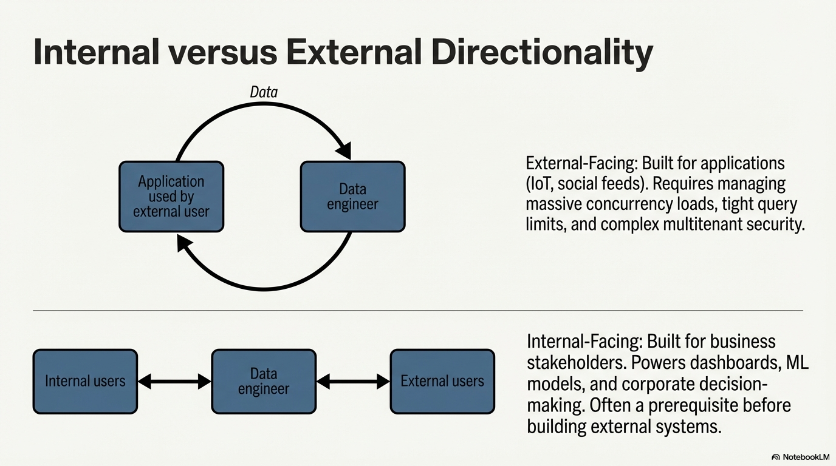

Slide 14
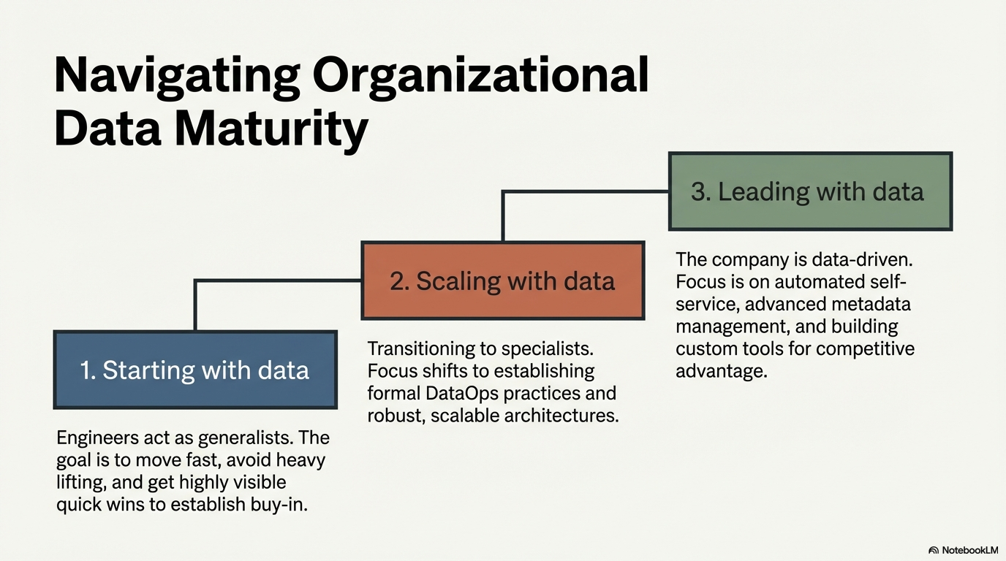

Slide 15
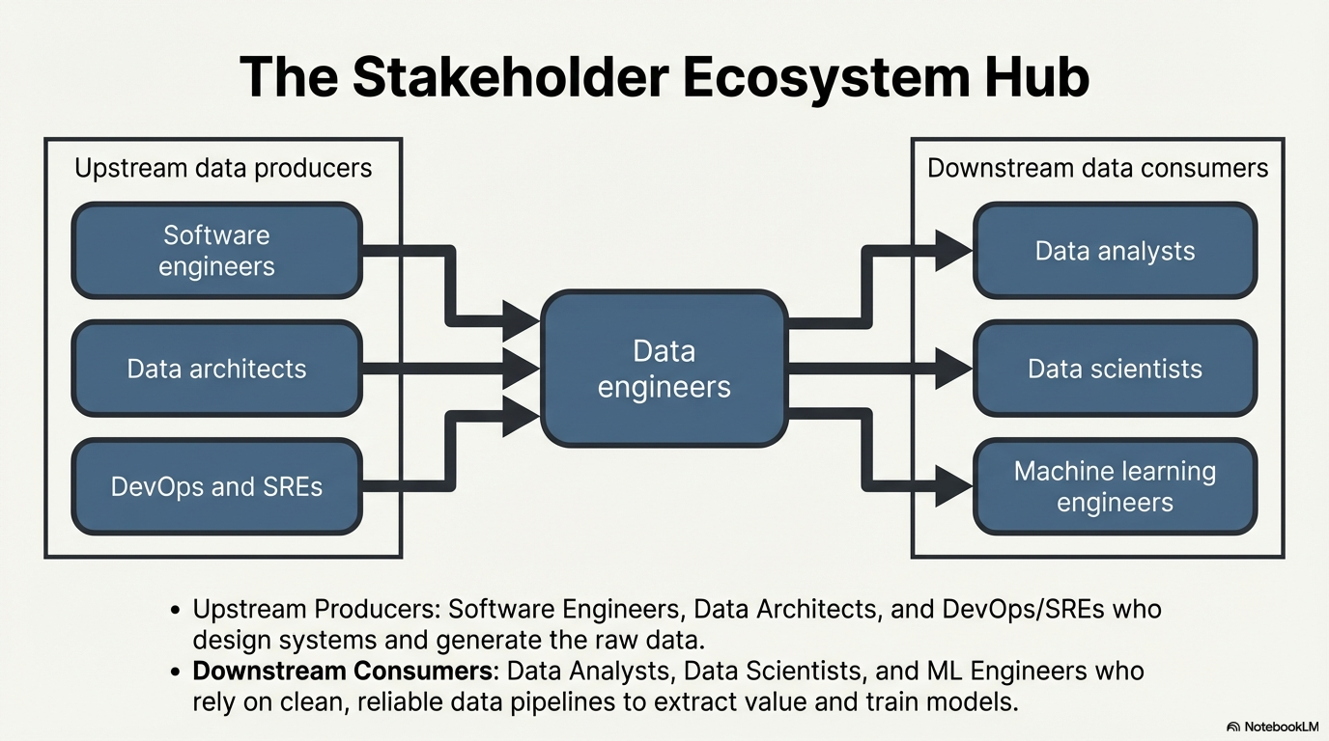

Slide 16
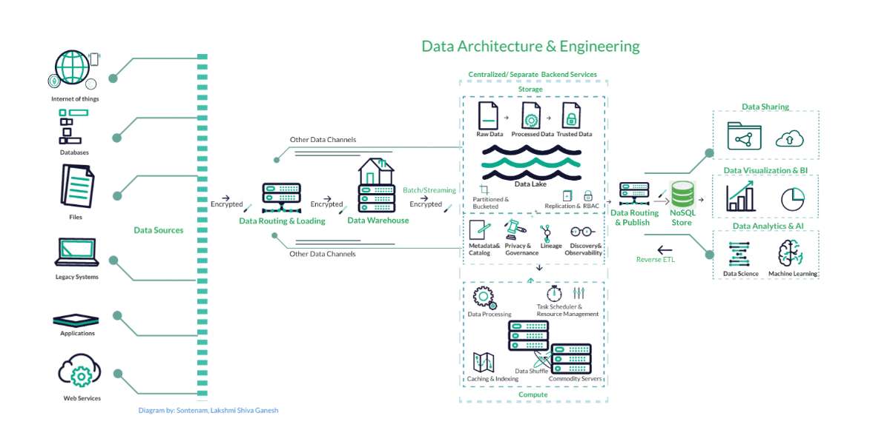
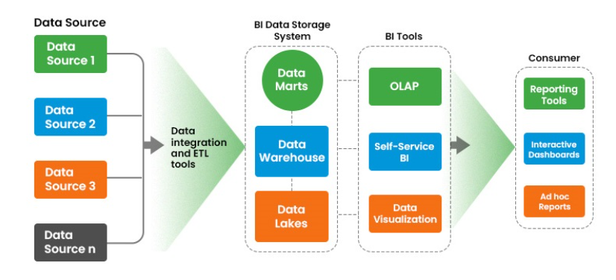
Data Engineering Architecture
Business Intelligence - Architecture

Slide 17
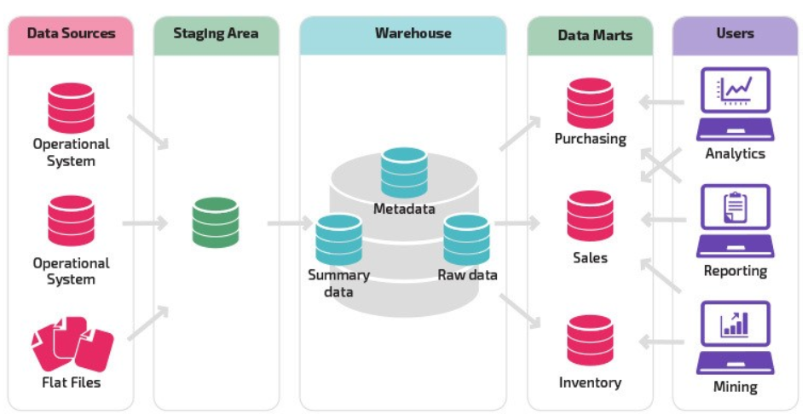

Slide 18
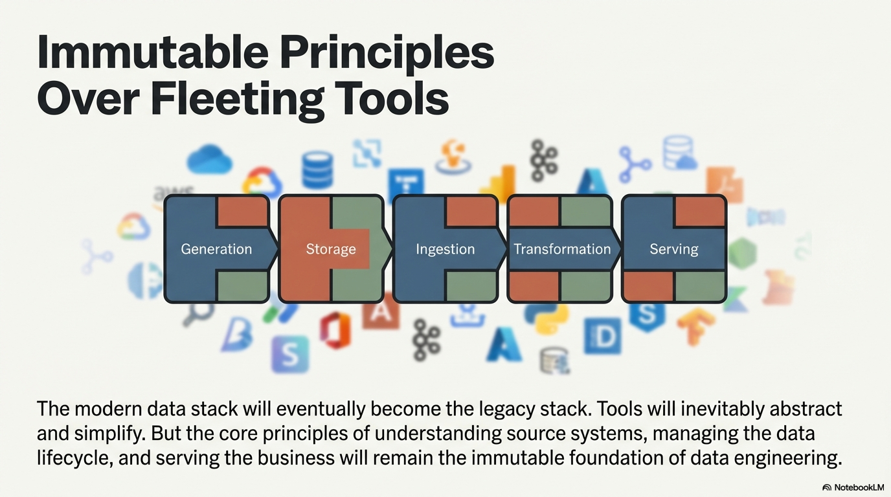

Slide 19
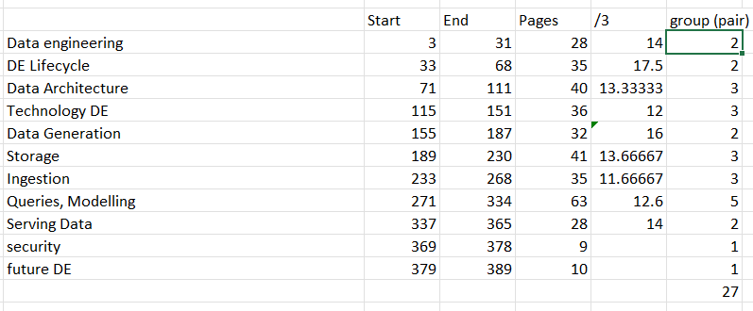

Group Discussion:
Canva Data Engineering Fundamental: https://www.canva.com/design/DAHEGdB5bH8/HcLySUreajqp6PVDBzLBTg/edit?utm_content=DAHEGdB5bH8&utm_campaign=designshare&utm_medium=link2&utm_source=sharebutton

